Slide 1

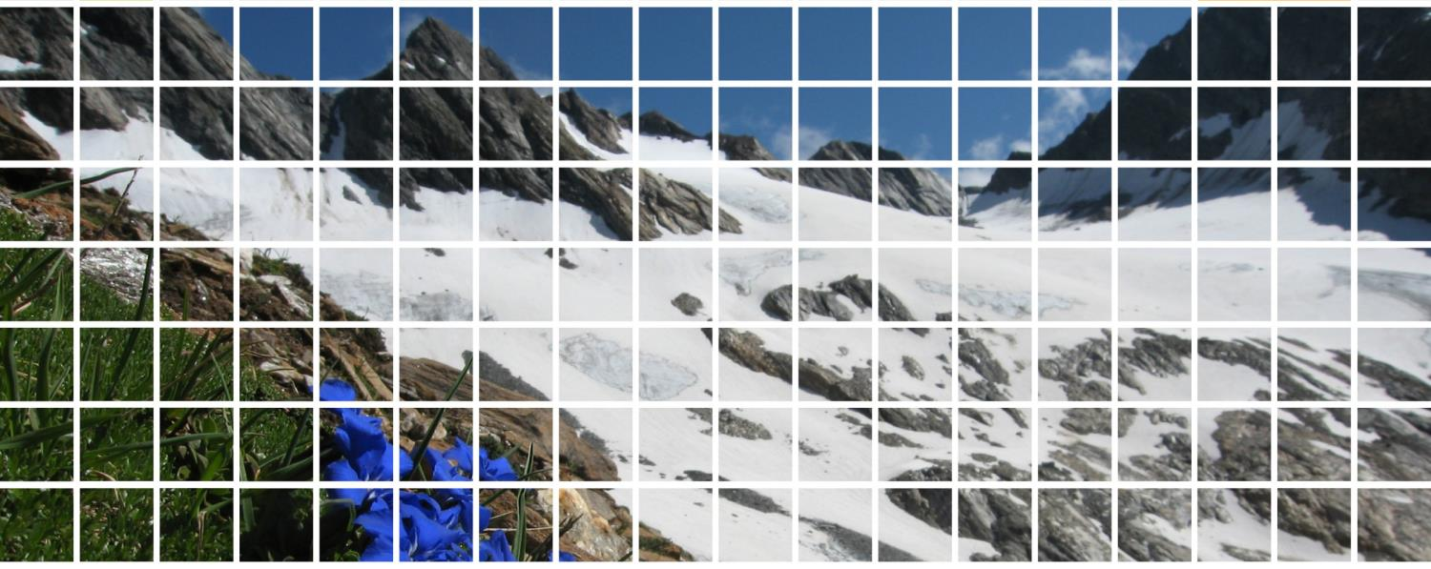
Faculty of Biology – Dept. of Botany
Info on MSc in Botany

Slide 2
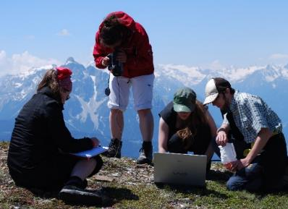
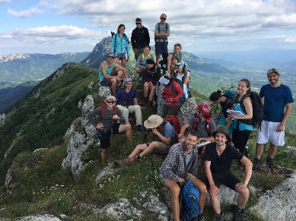
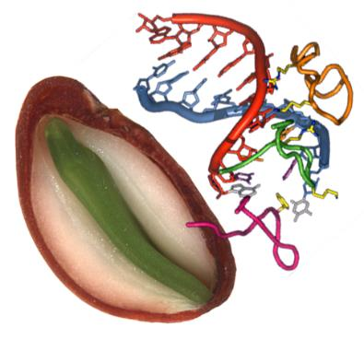
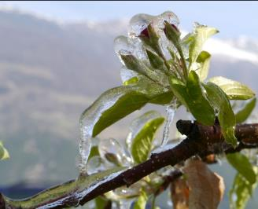
Faculty of Biology – Dept. of Botany
Optional modules
Various optional modules make up 100 ECTS

Slide 3
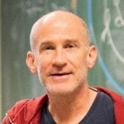
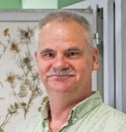
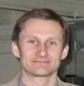
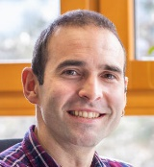
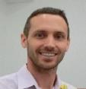
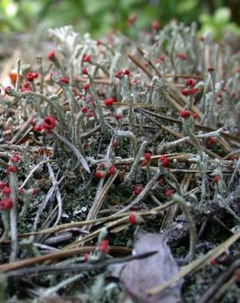
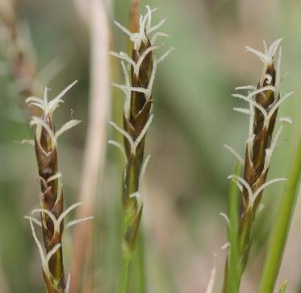
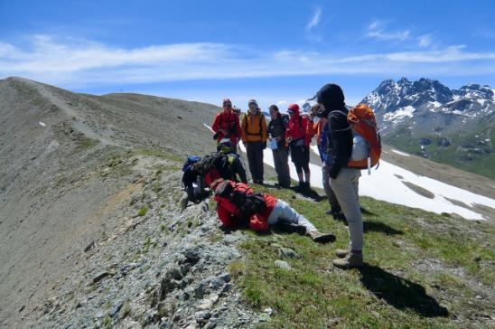
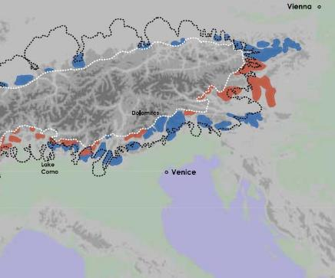
Faculty of Biology – Dept. of Botany
Plant diversity of selected native habitats
Plant diversity and systematics
Biogeography

Slide 4
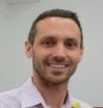
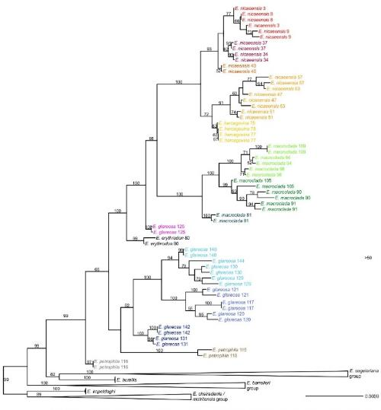
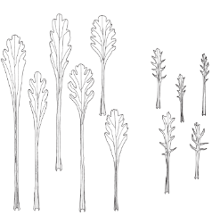
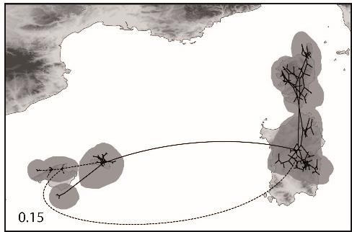
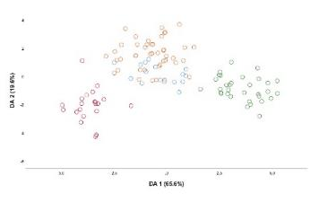
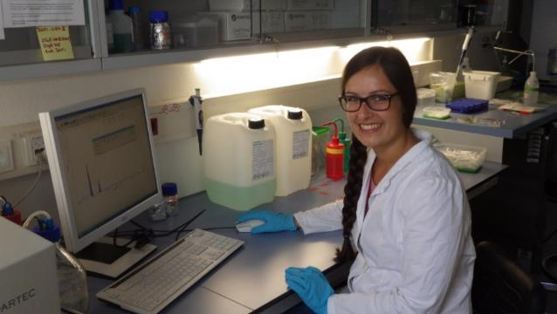
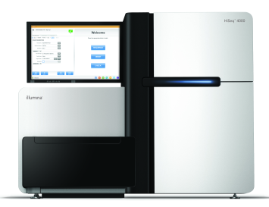



Faculty of Biology – Dept. of Botany
Methods of evolutionary research, plant systematics and biogeography

Slide 5
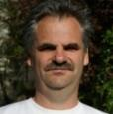
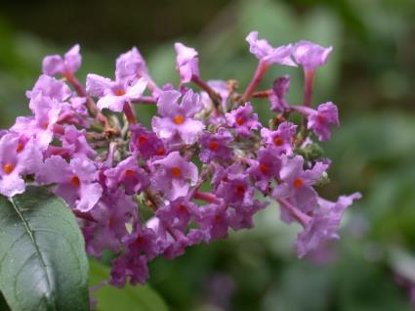
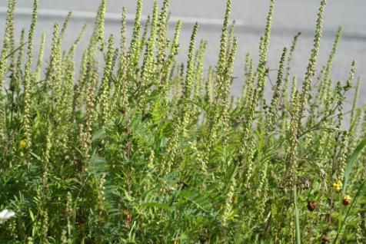
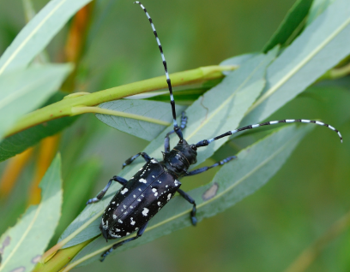
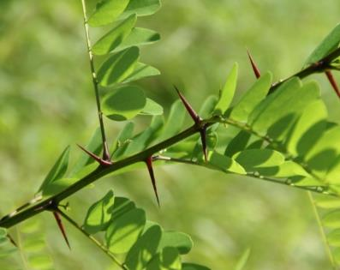
Faculty of Biology – Dept. of Botany
Biodiversity in transition
Anthropogenic flora and vegetation
Management
Man and environment
Neobiota
Notes:
Mensch-verursachte Veränderungen in Flora und Vegetation; Invasion von Neophyten und deren Auswirkungen auf Diversität, Umwelt und Mensch, Management invasiver Arten; Rückgang und Gefährdung heimischer Arten, Naturschutz

Slide 6

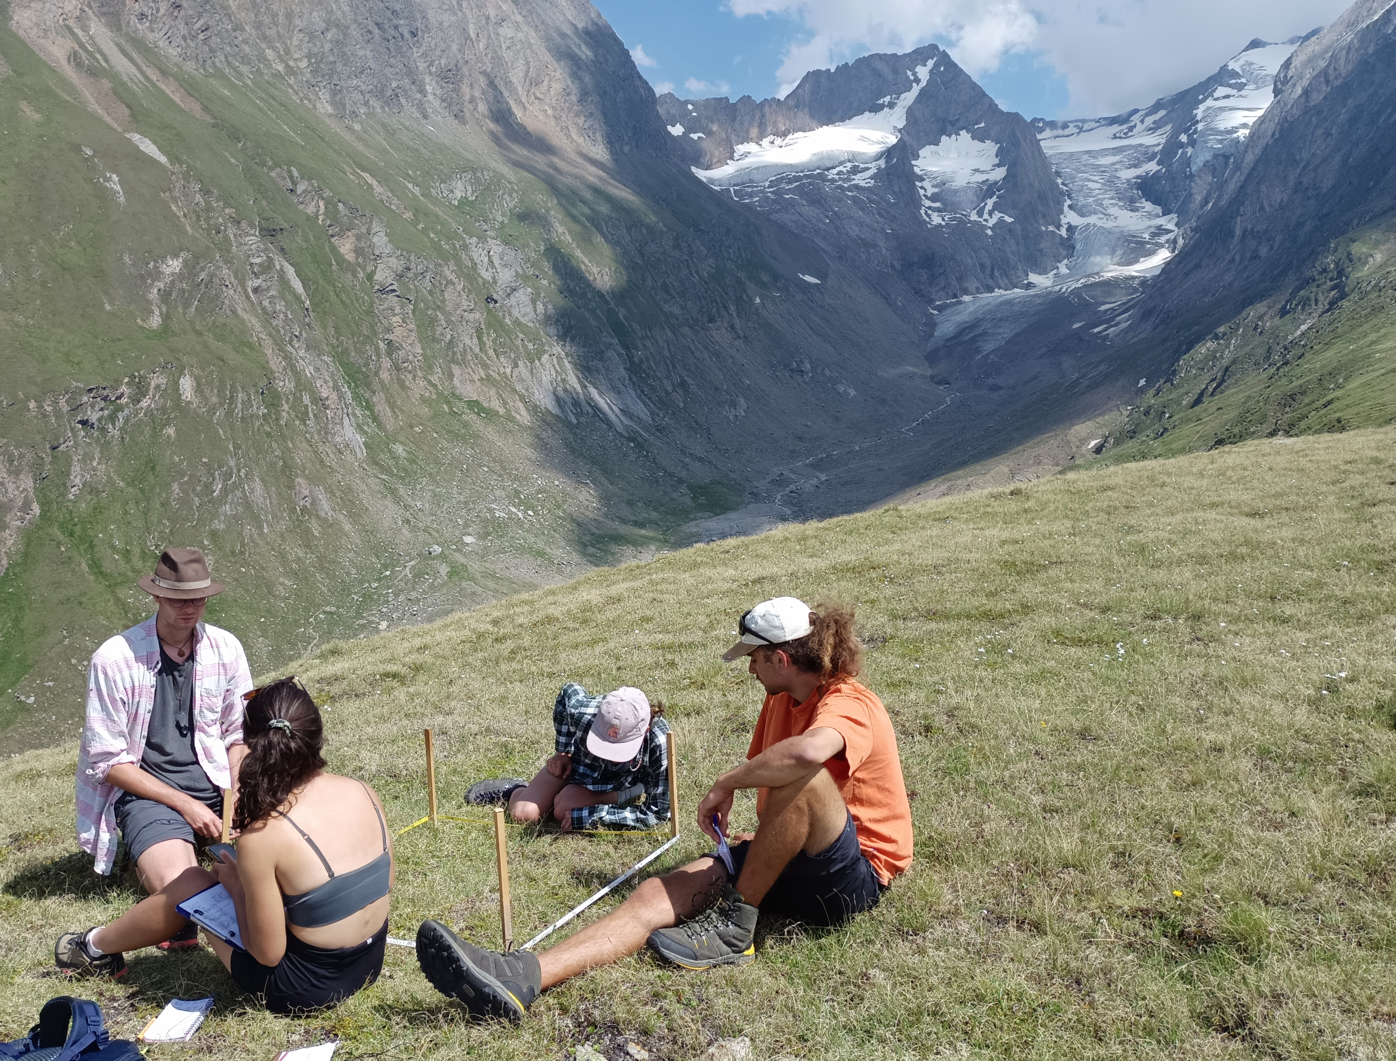
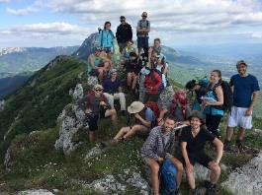

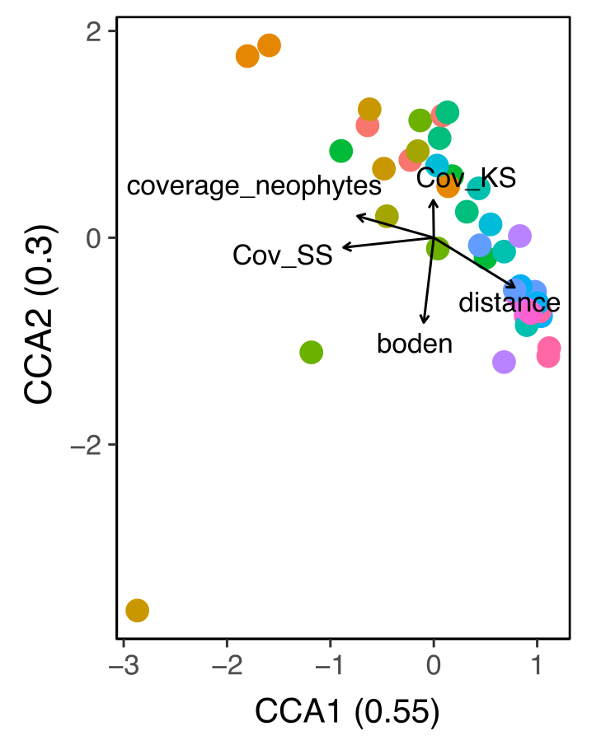
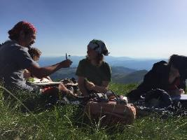
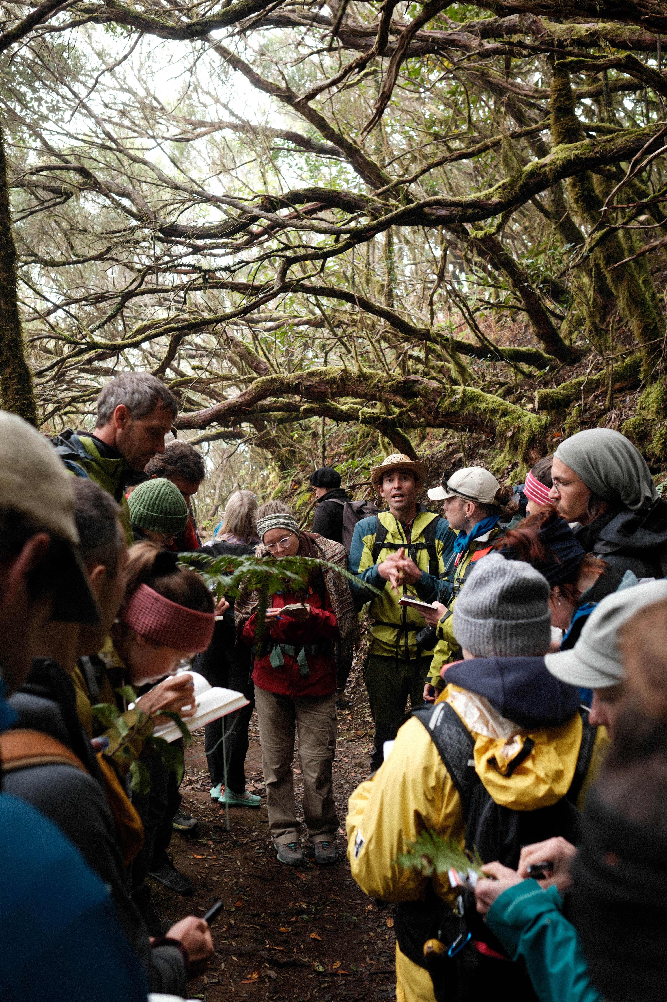
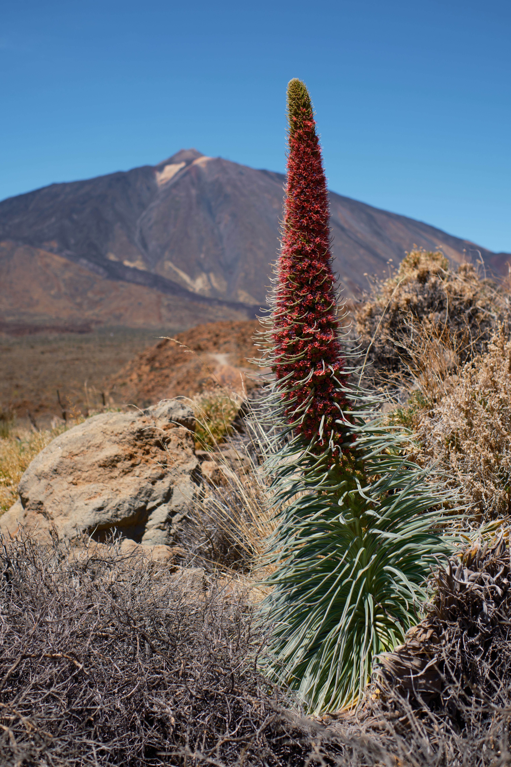
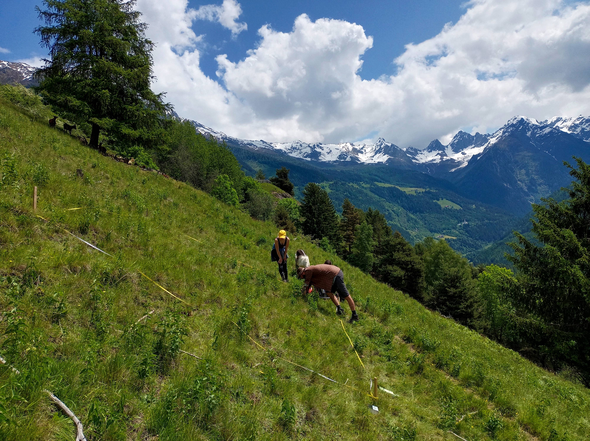
Faculty of Biology – Dept. of Botany
Vegetation analysis I
Vegetation analysis II

Slide 7
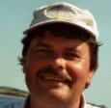
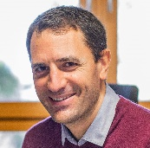
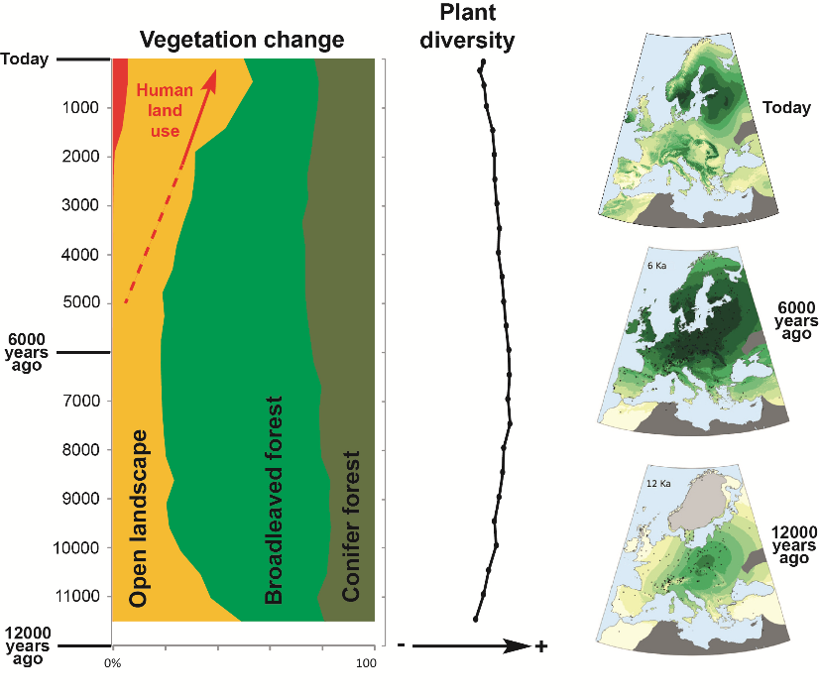
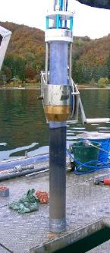
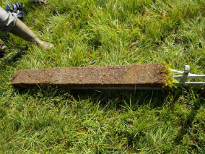
Faculty of Biology – Dept. of Botany
Vegetation in transition I
Palaeoecological concepts and methods
Vegetation und climate change in the quarternary / Paleoecology
Climate
Vegetation
Land
use
Sediment cores
Notes:
Methods related to paleoecology, how to reconstruct past vegetation. Examination of pollen from cores from lakes, bogs
Interactions climate-landuse-vegetation, what factors explain vegetation changes along history? Pollen + modelling to estimate land cover and plant diversity. Figure: modelling of forest cover in Europe

Slide 8
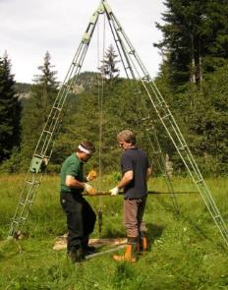

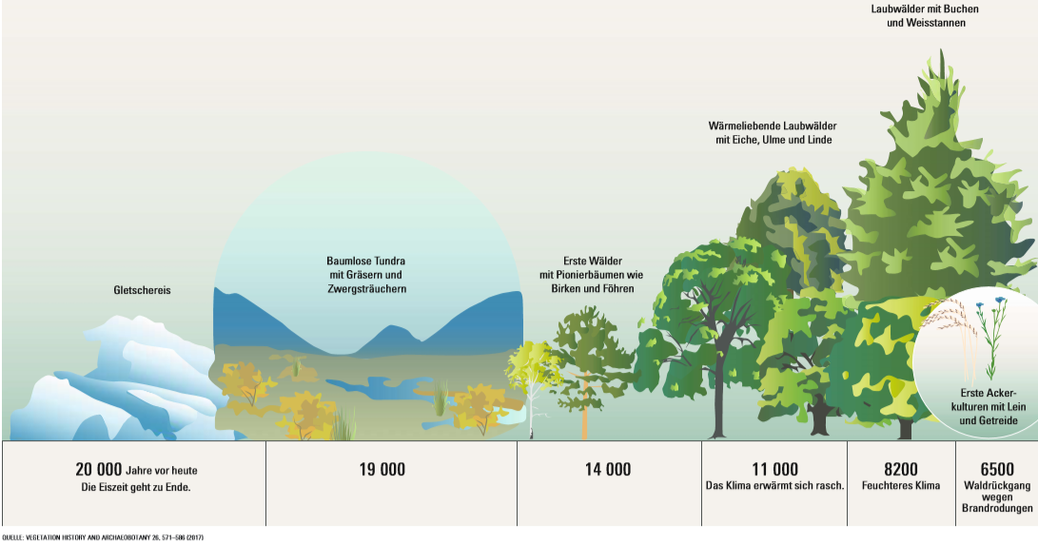
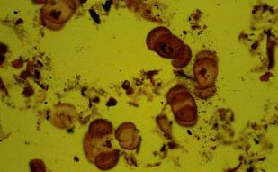
Faculty of Biology – Dept. of Botany
Vegetation im transition II
Palynology and Archaeobotany: The Human Factor
Holocene vegetation development in Central Europe
Paleoecology
Vom Bohren von Mooren und Seen bis zum Mikroskop
Pollenanalytische Rekonstruktionen, und die
Botanische Zeitreise durch die letzten 20000 Jahre
Notes:
Focused in the human factor (land use) and recent history (Holocene). Pollen + Macrofossiles

Slide 9
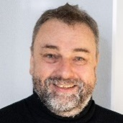
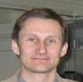
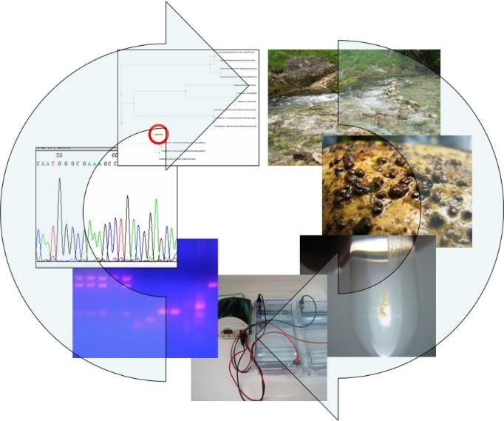
Faculty of Biology – Dept. of Botany
Hydrobotany
Molecular Taxonomy & Ecophysiology of algae
Combination of traditional taxonomic and molecular taxonomic investigations for the functional and ecological evaluation of running waters
Notes:
Focus on Electronic microscopy of Algae
Kombination von traditionell taxonomischen und molekular-taxonomischen Untersuchungen zur funktionalen und ökologischen Bewertung von Fließgewässern in Theorie und Praxis
Electronic microscopy

Slide 10
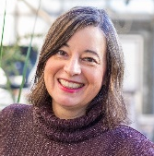
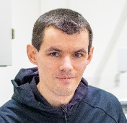
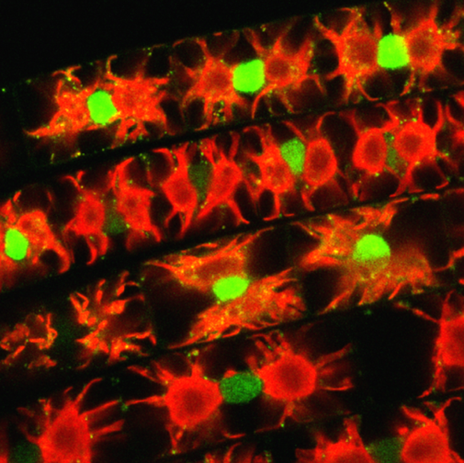
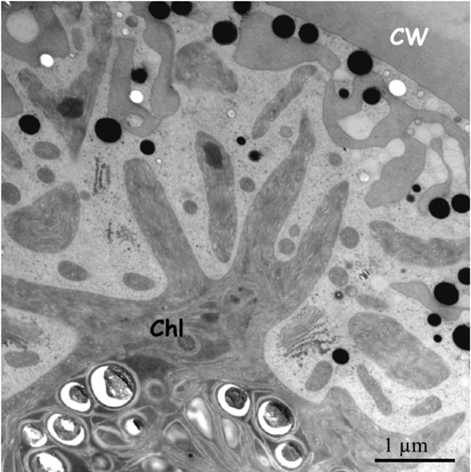
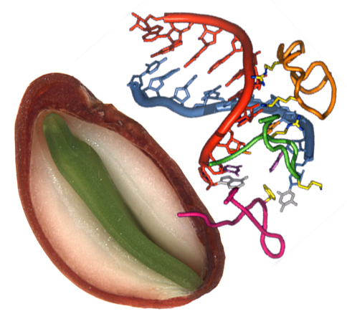
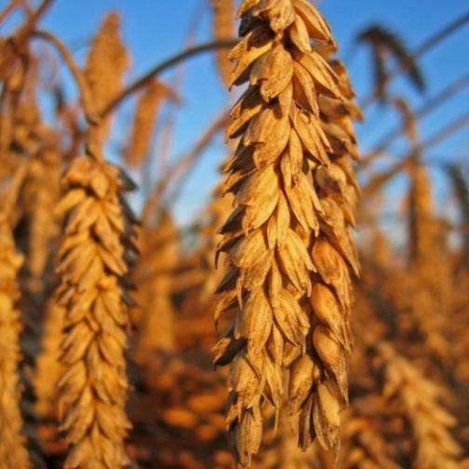

Faculty of Biology – Dept. of Botany
Cell biology
Physiology I: metabolism and biochemistry
Green algal cell in the transmission electron microscope
Impact of climate change on seed quality
Notes:
Zellbiologie / Holzinger: investigation of algal anatomy with con-focal laser-scanning microscopy and electron-microscopy
Physiolie / Kranner + Arc: Metabolite and antioxidant profiling of seeds and the influence of environment on seed quality

Slide 11












Faculty of Biology – Dept. of Botany
Physiology II: Development
Physiology III: Stress
Notes:
Developmental physiology / Roach: Investigation of developmental processes, such as germination, tropism and senscence, and the role of phytohormones. Molecular techniques to characterise knock-out mutants.
Stress physiology / Roach + Neuner: Lab and field-based courses to demonstrate stress tolerance mechanisms of plants and algae

Slide 12






Faculty of Biology – Dept. of Botany
Ecophysiology I: Plants and environment
Ecophysiology II: Alpine plants
Notes:
Deals with plants in their environment and reactions of plants to changing climate. Focus on adaptation to alpine climate. Students learn different methods used in the field and lab.

Slide 13






Faculty of Biology – Dept. of Botany
Ecophysiology III: Forestry and Agriculture
Notes:
Students get to know how theoretical knowledge and basic research is also of interest for applied research, for instance in forestry, recultivation or agriculture.

Slide 14







Faculty of Biology – Dept. of Botany
Ecophysiology IV: Tree growth
Climate and environmental factors on growth processes
Tree ring analysis - wood formation - growth physiology
Notes:
Students learn how growth and development of trees is influenced by biotic and abiotic conditions and how plants adatpt to extreme conditions. They learn dendrological techniques to study growth and reconstruct prior climatic conditions or biotic stresses (insects, pathogens)

Slide 15
Faculty of Biology – Dept. of Botany
Which courses are taught in English?

Slide 16



Faculty of Biology – Dept. of Botany
Scientific work / Masterarbeit (15 ECTS)
ca. 6 month research project on a selected theme within a research group, with the aim of publishing results in an international scientific journal.
Defence of the MSc thesis (2.5 ECTS)
Selected topics in plant science (Botanical Seminar: 1,5 ECTS; Botanical Colloquium: 1 ECTS)
presentation of own research results; structuring and design of publications
2) MSc thesis & other compulsory modules
Beste pflanzwissenschaftliche Master-Arbeit
Uni Innsbruck 2021

Slide 17
Faculty of Biology – Dept. of Botany
3) Karrieremöglichkeiten
Research: university and non-university (museums, EURAC, agricultural research institutes; national park/nature park management; other areas of life sciences, e.g. pharmacy, forestry and agriculture)
Nature- und Environmental protection
Technical office work und engineering (self-employed / company)
Other lab opportunities (e.g. Environmental analysis, limnology, seed industry, molecular biological laboratories)
Transdisciplinary: adult education; science journalism

Slide 18
Faculty of Biology – Dept. of Botany
3) Career opportunities - graduate survey
Where do our graduates work now?
n=38 Students (MSc Botanik, Lehramt-MSc with Botany, Diplomarbeit at the Dept. for Botany)
Notes:
Data from 2010-2018
Lehramt: Teacher training programme
Absolvent: Alumni

Slide 19
Faculty of Biology – Dept. of Botany
3) Career opportunities - graduate survey
How long did the job search take?
n=38 Students (MSc Botanik, Lehramt-MSc with Botany, Diplomarbeit at the Dept. for Botany)

Slide 20

Faculty of Biology – Dept. of Botany
3) Career opportunities – selected examples
Adriano Losso
Research Fellow at Western Sydney University
Michael Thalinger
Curator, Tiroler Landesmuseen
Research: universities, museums, pharmacy, forestry and agriculture

Slide 21




Faculty of Biology – Dept. of Botany
3) Career opportunities – selected examples
Lisa Silbernagl
Stellvertretende Fachbereichsleiterin
Bayerische Akademie für Naturschutz und Landschaftspflege
Lena Nicklas
Geschäftsführung
Naturpark Tiroler Lech
Elisabeth Falkeis
Naturschutz und Projekte
Naturpark Kaunergrat
Nature and environmental protection

Slide 22

Faculty of Biology – Dept. of Botany
3) Career opportunities – selected examples
Nature and environmental protection
Environmental departments/nature conservation departments of the federal states, Federal Environment Agency
Protected area management, protected area supervisor (country)
district authorities, municipalities
Agricultural and forest departments, waste and landfill management
Water management (water ecology, water quality)
NGOs: WWF, Greenpeace, Natopia, ÖAV, etc.
Agnes Erler
Bundesministerium für Klimaschutz, Umwelt, …
nature and environmental protection
Notes:
Agnes Erler is working for the federal ministry climate action, environment, energy, mobility, innovation and technology in Vienna. Master in Gilberts group

Slide 23

Faculty of Biology – Dept. of Botany
3) Career opportunities – selected examples
http://www.oekoteam.at
Iris Trenkwalder
Atelier Gstrein
Technical and engineering positions
Notes:
Anstellung seit: Oktober 2019
Hauptaufgabe: Vegetationskartierung, Beurteilung der Vegetation im Zuge von Einreichprojekten
Detailliertere Beschreibung: Bevor Projekte, wie etwa Wander- und Radwege, Skipisten oder Liftanlagen, neu errichtet werden dürfen bedarf es einer behördlichen Bewilligung. Im Zuge der Einreichung dieser Projekte bei einer Behörde ist eine Beschreibung der von den Baumaßnahmen betroffenen Vegetation nötig.
Meine Aufgabe ist die Darstellung der aktuellen Vegetation in Form einer Vegetationskarte, sowie das Verfassen eines Berichtes mit Vegetationsbeschreibung und Artenlisten zu den betroffenen Lebensräumen. Zusätzlich wird der Vegetationsbestand in Bezug auf den Schutzstatus und den Gefährdungsgrad der Lebensräume sowie der darin vorkommenden Pflanzenarten beurteilt und die Auswirkung der geplanten Maßnahmen auf diese Lebensräume und Pflanzenarten abgeschätzt.

Slide 24


Faculty of Biology – Dept. of Botany
3) Career opportunities – selected examples
Christina Schausberger, Quality control, Richter Pharma
Fabiola Morscher, Pharmacist
Theresa Baur, QS officer, Kalb Analytik
David Clara, Eurofins Genomics
Divisions with laboratory requirements
(environmental analysis, seed industry, molecular biological laboratories, scientific services)

Slide 25

Faculty of Biology – Dept. of Botany
3) Career opportunities – selected examples
Karin Kompatscher
Curator und garden teacher
Schloss Trautmannsdorf
Ramona Roach
Nature teacher
Grüne Schule, Uni Innsbruck
Bildung
Notes:
Popular science, educators

Slide 26



Faculty of Biology – Dept. of Botany
Summary: Why study MSc Botanik?
Broad range of study opportunities
Excellent supervisory relationship
Cooperation with non-university organizations
Good chances with finding a job
Strong involvement in research projects and networks

Slide 27


Faculty of Biology – Dept. of Botany
MSc Botanik
... and we look forward to interested students!

