Slide 1
Media, Society & Communication
Introduction – Part I

Slide 2
Human Bingo

Slide 3
Structure uibk
Faculty for political and social sciences
Sociology
Political sciences
Media, society & communication
Institutes
Uta Rußmann
Viorela Dan
Notes:
The University of Innsbruck is structured by faculties of different academic fields. They include 16 different faculties. Our study program belongs to the Faculty of political and social sciences.
Afterwards faculties are divided into 80 institutes.
Our study program is organized by the institute for Media, Society and Communication, which belongs to the faculty of political and social sciences.
The head of the media, society and communication institute is Uta Rußmann.
Your contact on study related things is Viorela Dan.
Both of them will join us later.

Slide 4
LFU online & OLAT
Most important platforms during your studies
LFU: https://lfuonline.uibk.ac.at/public/lfuonline.home
+ Uni-Innsbruck APP
OLAT:
https://lms.uibk.ac.at/dmz/
Notes:
Mavin

Slide 5
USI
Uni Sportstätten
https://usi.uibk.ac.at/usi/page
Additional
WiFi access
Office 365 access
VPN
Library access
Notes:
Mavin

Slide 6
Student life Innsbruck
☕
🎉

Slide 7
Student Life Innsbruck
Good to know - Benefits
Freizeit Ticket („Leisure ticket“)
Skiing resorts around Innsbruck; swimming pools; Museums etc.
from now on until the the 31st of October for early bird price: 872€
Erlebniscard Tirol („Tyrol Adventure Card“)
Free/Reduced price activities all over Tyrol
Price: 99€
Snowcard Tirol
Access to all skiing areas in Tyrol
Pre-sale price: 989€
Free city bike
Download App „nextbike“ and register with your uni mail for free access to the bikes across Innsbruck
Cheaper tickets for Raiders football home games (check online in advance!)
Student account (savings bank)
Free access to „Tiroler Tageszeitung“ online; https://studierendenaktion.tt.com
Notes:
Das is noch von damals, kann gern angepasst werden

Slide 8
Student Life Innsbruck
Bars & Restaurants
€€ and/or „special“
€ and casual
Treibhaus
Krahvogel
Fuchs & Hase
Bar Centrale
Dom Café
Blaue Brigitte
360Grad Bar
Limerick‘s
Galway Bay
Kater noster
Montagu
Tribaun (!Pub Quiz!)
Treibhaus
Dinzler
Wettercafé
Friends Bar (former Bacchus)
PM Bar (!Pub Quiz!)
TnT Sportsbar
Marktbar
Moustache
Cocktailbar C.U.
Wohnzimmer
Restaurants
Machete (Burritos)
Una Pizza
Due Sicilie (Pizza)
Jaipur & Himal (Indian & Nepali)
Meow Pizzeria Verde (all vegan)
Olive (all vegan)
Pobo (Poké Bowls)
My indigo
Glorious butcher (Burger)
Notes:
Das is noch von damals, kann gern angepasst werden

Slide 9
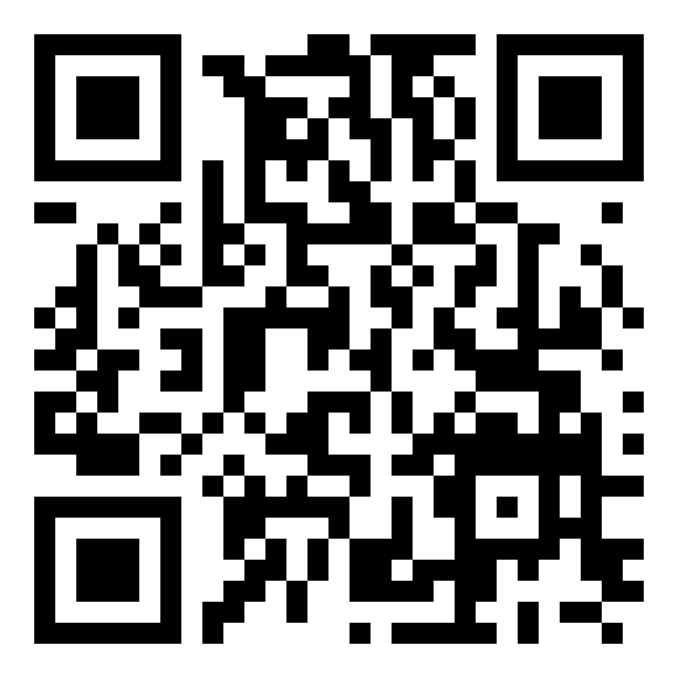
Student Life Innsbruck
Cafés
Overview/List
Haepinest (Brunch & cakes)
Karaffu (Best matcha & cakes)
Verena‘s (The BEST cakes)
Wilten Brunch/Bar (Great Chai latte)
Starbucks (free WiFi)
Kaffeegesellschaft (Coffee specialities)
Schmeckeria (Brunch)
La Cantina (Croissants & italian coffee)
Café Momo (at the book store „Wagner‘sche“)
Notes:
Das is noch von damals, kann gern angepasst werden

Slide 10
Media, Society & Communication
Introduction – Part 2

Slide 11
Prerequirements
Complementary subject area Bachelor – Media & Communication (30 ECTS)
1. Social Communication and Media Change
2. Theoretical and Methodological Fundamentals
3. Specialization in Media and Communication Science
Important: if you have been approved to the master´s programme with some conditions which have to be done until the end of the second semester you have to inform the Prüfungsreferat after passing the courses. Prüfungsreferat can be translated as the department of examination.
Notes:
To give you a quick overview what is coming your way during this program, we are going to give you a quick ride through the curriculum.
As you might know, the Conditions to be accepted for the masters program is the Complementary subject area Bachelor – Media & Communication which consists of 30 ECTS
By now you should already know which courses you need to catch up – IMPORTANT you need to inform the "Prüfungsreferat - Sowi" by yourself when you have completed these.
Viorela wird ab da dabei sein, da könnte man nochmal die Frage stellen, ob alle ihre passenden Kurse haben oder noch Fragen haben

Slide 12
Compulsory modules
Elective modules
Media Theory
Scientific work (quanitative/qualitative work)
Current discourses
e.g. AI, platforms, online political discourse, journalistic representation ...
Election packages: for example "Media practice"
Internship
Interdisciplinary
Notes:
In general the curiculum is split up in compulsory modules and elective modules.
In the compulsory modules you will learn about media theory, scientific work (interviews, experiments, data analysis R etc.) and current discourses e.g. AI, platforms, online political discorse, fake news etc.
You can choose your elective modules freely and follow your interests. There are three different types of elective modules: election packages (Minors), interdisciplinary and internships. Lisa will explain the regularities about the combination of the elective module to you afterwards.
If you want to go further in the direction of media in a journalistic context, a lot of students recommend the election package/minor "Media practice"

Slide 13
Future
Work areas
Social Media & Community management
Radio
Journalistic activities
Platform support & digital marketing
Event management & public relations
Public relations for law
Political communication
PhD
Notes:
A lot of the master students are already working in suitable jobs or did an internship. To give you an idea of what to do after the masters program, this could be possible working areas:
PhD kann evtl die Viorela kurz was dazu sagen

Slide 14
Curriculum https://www.uibk.ac.at/universitaet/mitteilungsblatt/2022-2023/30.html#h2-1

Slide 15
Compulsory modules
CM 1 | Advanced theory | ECTS
 | VU Emerging Media and Current Discourses | 5
 | VO Media dynamics and sustainability | 5
 | VO Digital Democracy and Society | 5
CM 2 | Advanced methodology | 15
 | VO Theories and Methodology | 5
 | SE In-depth qualitative methods | 5
 | SE In-depth quantitative methods | 5
CM 3 | Digitization and datafication l | 30
 | VU Platforms and Communication | 5
 | SE Data: Analysis and interpretation | 5
CM 4 | Digitization and datafication ll | 40
 | VU Ethics and Governance | 5
 | SE Data: Critical analysis | 5
 |  | 50
CM 5 | Research project | ECTS
 | SE Research project | 10
CM 6 | Master's thesis preparation | 2,5
CM 7 | Master thesis defense | 2,5
§ 9 | Master thesis | 25
 | Total ECTS CM | 90
+ elective modules | Total ECTS | 30
= 120 ECTS

Slide 16
Modular elective modules
The individual elective modules, e.g. interdisciplinary skills, individual specialization 1+2 & practice 1+2 can be freely combined with each other, but only as WHOLE modules.
Examples:
Interdisciplinary skills (10 ECTS) + individual specialization 1 (10 ECTS) + individual specialization 2 (10 ECTS) = 30 ECTS elective modules
Or
Interdisciplinary skills (10 ECTS) + Practice 1 (10 ECTS) + Individual specialization 1 (10 ECTS) = 30 ECTS

Slide 17
Elective modules
30 ECTS according to modular principle
WM 1 | Interdisciplinary skills | ECTS
 | Courses amounting to 10 ECTS-Credits [...] can be chosen freely. It is compulsory to complete a course in the field of Gender Studies, Women's and Gender Studies. | 10
= Individual courses, e.g. VO, PS, VU etc.
Must be at least 10 ECTS, but more are also possible.
1 course with a background in gender studies, women's and gender studies compulsory
WM 2 | Individual focus I | ECTS
 | Modules [...] can be freely selected for individual specialization. It is strongly recommended to complete a course in the field of Gender Studies, Women's and Gender Studies. | 10
= Whole modules, e.g. slide 10.
Must have at least 10 ECTS, but more are also possible.
e.g. 7.5 ECTS + 3 ECTS
WM 3 | Individual focus II | ECTS
 | s. Individual focus l | 10

Slide 18
Elective modules 30 ECTS according to modular principle
Example areas:
Media and cultural work as well as institutional media work (e.g. in agencies, publishing houses, media companies, broadcasters)
Media research and opinion, market and survey research
Public relations and media and communications consulting
Media and communication management as well as content and program management
Evaluation of communication services, media strategies and media campaigns
Media policy
Media education and training in the fields of media and communication
Publishing and book trade, journalism
WM 4 | Practice l | ECTS
 | [...] professional practice and for the acquisition of professionally relevant qualifications to complete 225 hours of practical training. Approval must be obtained from the Director of Studies prior to commencement. A certificate from the institution must be submitted regarding the duration, scope and content of the work completed and the student's commitment, and a report in written form or in the form of a video clip must also be prepared, which includes documentation of learning experiences in addition to objectives and activities. (25 working hours will be charged for the report). | 10
WM 5 | Practice ll | ECTS
 | s. Practice 1 | 10
Prerequisite: at the earliest after completion of 30 ECTS

Slide 19
Important
PREREQUISITES
NOT CREDITABLE
Graded
Prerequisites for the respective courses must be fulfilled
at the University of Innsbruck,
Master courses
ISI language courses
USI courses
"successfully participated"
(except internships)

Slide 20
1
VO "Psychoanalytical Educational Science" = individual course with 5 ECTS, can be credited as interdisciplinary competences
2
Same course, different teacher and time. SE must of course only be taken once -> 10 ECTS
3
"Elective module 3: The unconscious in education, training and culture = entire module consisting of 10 ECTS, can be credited as an individual specialization.

Slide 21
Election package (minor)
"Instead of the elective modules, an elective package for Master's studies can be completed subject to availability. Elective packages are defined modules from one's own and other disciplines amounting to 30 ECTS-Credits [...]"
If the elective package is completed, all the things mentioned above are irrelevant because the whole package is credited with 30 ECTS and the elective modules are therefore full
Not all courses every semester
Package not finished?
Interdisciplinary skills (max. 10 ECTS)
Individual focus (whole modules only)

Slide 22
Let‘s connect! WhatsApp group

